Slide 1


TRADE-OFF BETWEEN PERFORMANCE AND PRIVACY IN MEDICAL IMAGE CLASSIFICATION BY DIFFERENTIAL PRIVACY ANALYZING THE SECURITY.

Slide 2

PRESENTED BY:
GROUP ID-T2320050
Sumaiya Haque
23141039
Computer Science and Engineering
BRAC University
Dhaka, Bangladesh
Email:
sumaiya.haque2@g.bracu.ac.bd
Mohammad Azim Mehraj
23141050
Computer Science and Engineering
BRAC University
Dhaka, Bangladesh
Email:
mohammad.azim.mehraj@g.bracu.ac.bd
Md Tanzim Reza
Supervisor
Computer Science and Engineering
BRAC University
Dhaka, Bangladesh
Email: tanzim.reza@bracu.ac.bd
Mohammad Faiazur Rahman
20101423
Computer Science and Engineering
BRAC University
Dhaka, Bangladesh
Email: mohammad.faiazur.rahman@g.bracu.ac.bd
Rafeed Rahman
Co-Supervisor
Computer Science and Engineering
BRAC University
Dhaka, Bangladesh
Email: rahman.rafeed@bracu.ac.bd
Mahmud Abedin
20301366
Computer Science and Engineering
BRAC University
Dhaka, Bangladesh
Email:mahmud.abedin@g.bracu.ac.bd

Slide 3
TABLE OF
CONTENTS

Slide 4
01. BACKGROUND INFORMATION
02.WORKFLOW
03.DATASET
04.DATA ANALYSIS AND PREPROCESSING
05.PROPOSED METHODOLOGY AND ARCHITECHTURE
06. RESULT AND ANALYSIS
07.FUTURE WORK
08. ACCEPTED,PRESENTED & SUBMITTED PAPERS
09.CONCLUSION
10. REFERENCE

Slide 5
Background Information

Slide 6
Lack of data security undermines patient trust in the healthcare system.
Data leakage can cause significant issues for patients and healthcare providers as studies highlight the risk of re-identification attacks, where anonymized data can still reveal individual identities.
Examples include the re-identification of Governor William Weld and Netflix users despite anonymization efforts.
Ensuring data privacy could enable broader sharing of medical data for research without compromising patient confidentiality.
Methods like differential privacy can prevent re-identification and maintain data utility, fostering more secure data-sharing practices.

Slide 7
Workflow

Slide 8
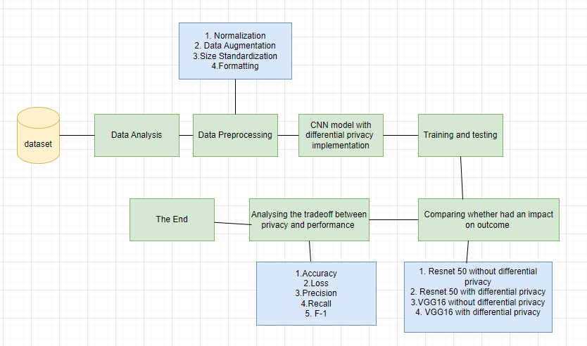
FIG 1. WORKFLOW

Slide 9
Dataset

Slide 10
Dataset Structure:
Contains subfolders for each image category: Pneumonia and Normal.
Dataset Composition:
There are a total of 5,863 X-Ray images (JPEG format).
There are two categories: Pneumonia and Normal.
Source and Selection:
The chest X-ray images were selected from pediatric patients (ages 1-5 years) in Guangzhou.
Women and Children’s Medical Center, Guangzhou.
Imaging was performed as part of routine clinical care.
Quality Control:
Initial quality control screening to remove low-quality or unreadable scans.
Diagnoses were graded by two expert physicians.
Validation and Accuracy:
The evaluation set is checked by a third expert to account for grading
errors.

Slide 11
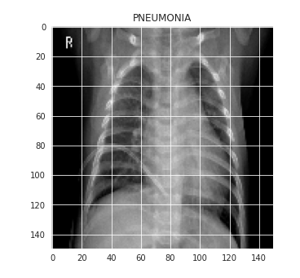
Fig2: Sample Data Visualization of the data set

Slide 12
Data Analysis and preprocessing

Slide 13
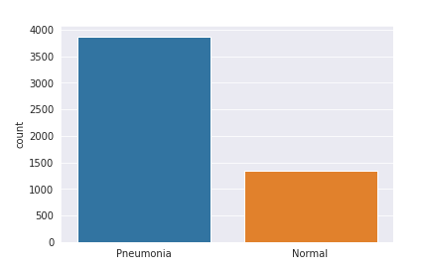
Data Visualization
The data seems imbalanced . To increase the no. of training examples, we will use data augmentation.

Slide 14
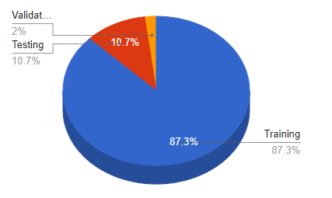
First, the images were resized
We split our dataset into 3 sets training, validation, and testing . The dataset comprises a total of 5,863 X-ray images, which are divided into three subsets: training, testing, and validation. The training set consists of 5,216 images, accounting for approximately 86.95% of the total dataset. The testing set includes 624 images, making up about 10.64% of the dataset. Finally, the validation set contains 16 images, representing around 2.27% of the total.

Slide 15
We used data augmentation to reduce overfitting
For the data augmentation, we chose to :
Randomly rotate some training images by 30 degrees
Randomly Zoom by 20% some training images
Randomly shift images horizontally by 10% of the width
Randomly shift images vertically by 10% of the height
Randomly flip images horizontally. Once our model is ready, we fit the training dataset.

Slide 16
Proposed Methodology and Architecture

Slide 17
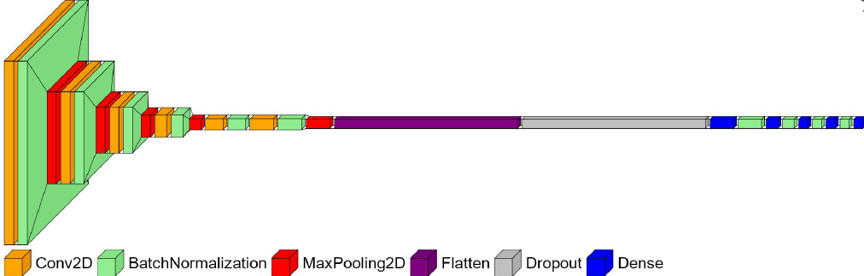
Methodology of the CNN Model Without differential Privacy:
Input Size: 150 x 150 x 1 (Grayscale Image)
5x Conv2D Layers:
32 filters, (3 x 3) filters
64 filters, (3 x 3) filters
64 filters, (3 x 3) filters
128 filters, (3 x 3) filters
256 filters, (3 x 3) filters
4x Dropout Layers:
Dropout (0.1)
Dropout (0.2)
Dropout (0.2)
Dropout (0.2)
5x Batch Normalization Layers
5x MaxPooling2D Layers:
(2 x 2) pool size
1x Flatten Layer
2x Dense Layers:
128 units, ReLU activation
1 unit, Sigmoid activation
Optimizer: SGD
Loss Function: Binary Cross-Entropy
Metrics: Accuracy

Slide 18
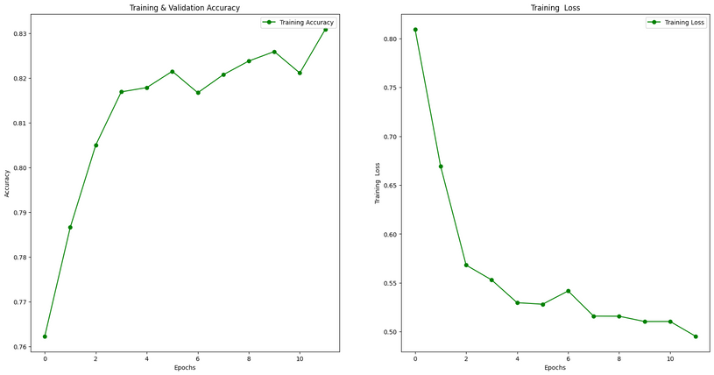
Methodology of the CNN Model with Differential Privacy:
Differential Privacy Settings:
l2_norm_clip: 0.3
noise_multiplier: 0.1
num_microbatches: 16
Optimizer: Differentially Private SGD Optimizer (DPKerasSGDOptimizer)
learning_rate: 0.01
Loss Function: Binary Crossentropy
from_logits: False
Metrics: Accuracy
Training Parameters:
epochs: 12
batch_size: 32
This differentially private model uses a specialized optimizer to ensure privacy during training by adding noise to gradients and clipping their norms. The architecture is designed to extract features from grayscale chest X-ray images and perform binary classification to detect pneumonia. The model configuration balances privacy with learning performance.

Slide 19
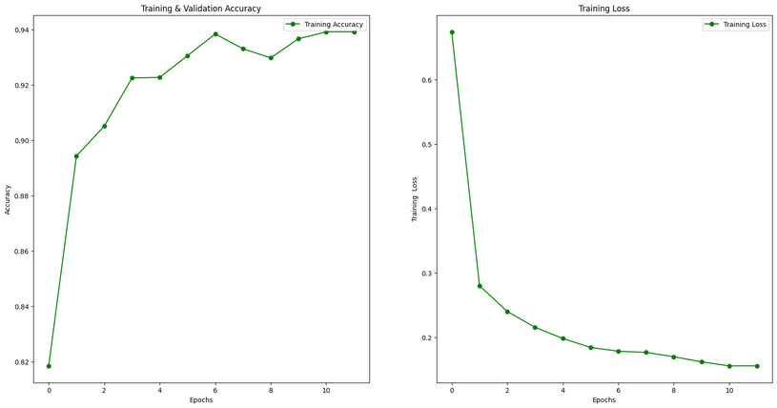
Normal Resnet50:
Input Size: 150 x 150 x 1 (Grayscale Image)
Base Model: ResNet50 with pre-trained ImageNet weight
Custom Fully Connected Head:
Flatten Layer
Dense Layer with 1024 units and ReLU activation, followed by Dropout (0.5)
Dense Layer with 512 units and ReLU activation, followed by Dropout (0.5)
Dense Layer with 256 units and ReLU activation, followed by Dropout (0.5)
Output Layer: Dense Layer with 1 unit and Sigmoid activation
Parameters:
Data Augmentation:
Rotation Range: 90 degrees
Horizontal and Vertical Flipping
Width and Height Shifting: 0.2
Zoom Range: 0.1
Optimizer: SGD
Loss Function: Binary Cross-Entropy
Batch Size: 32
Number of Epochs: 12
Steps per Epoch: 163
Dropout Rate: 0.5
Final Layer Activation: Sigmoid (for binary classification)
Metrics: Accuracy

Slide 20
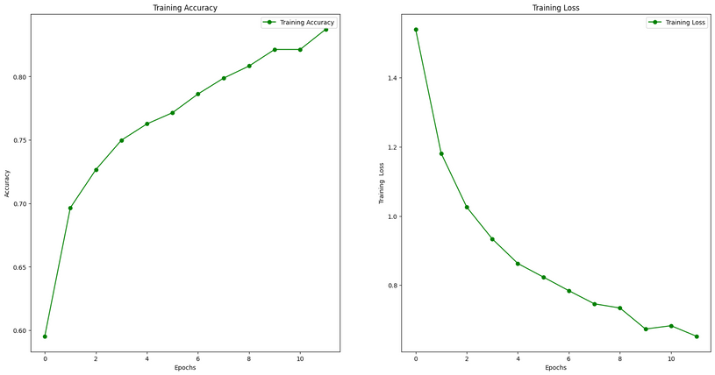
Resnet50 with Differential Privacy:
Architecture:
Input Size: 150 x 150 x 3 (RGB Image)
Base Model: ResNet50 with pre-trained ImageNet weights, excluding top layers
Custom Fully Connected Head:
Flatten Layer
Dense Layer with 1024 units and ReLU activation, followed by Dropout (0.5)
Dense Layer with 512 units and ReLU activation, followed by Dropout (0.5)
Dense Layer with 256 units and ReLU activation, followed by Dropout (0.5)
Output Layer: Dense Layer with 1 unit and Sigmoid activation
Parameters:
Data Augmentation:
Rotation Range: 90 degrees
Horizontal and Vertical Flipping
Width and Height Shifting: 0.2
Zoom Range: 0.1
Differentially Private Optimization:
L2 Norm Clip: 1.5
Noise Multiplier: 0.1
Number of Microbatches: 8
Learning Rate: 0.01
Optimizer: Differentially private SGD (DPKerasSGDOptimizer)
Loss Function: Binary Cross-Entropy
Batch Size: 32
Number of Epochs: 12
Dropout Rate: 0.5
Final Layer Activation: Sigmoid (for binary classification)
Metrics: Accuracy

Slide 21
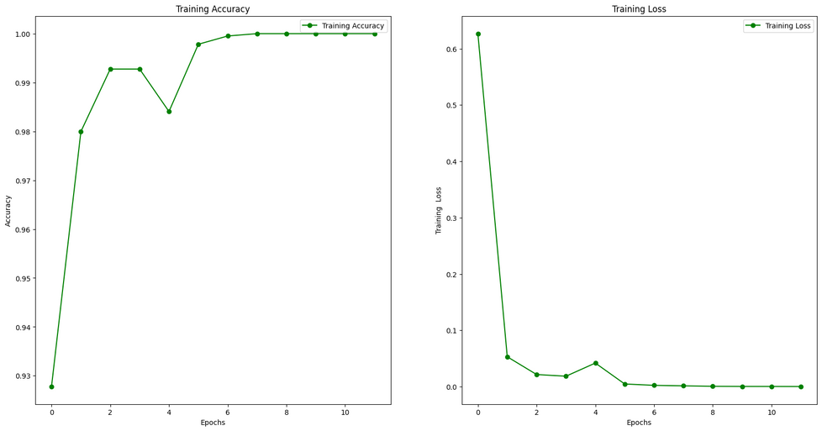
VGG 16
Architecture:
Input Size: 224 x 224 x 3 (RGB Image)
Base Model: VGG16 with pre-trained ImageNet weights, excluding top layers
Custom Fully Connected Head:
Flatten Layer
Dense Layer with 1024 units and ReLU activation
Output Layer: Dense Layer with the number of units equal to the number of classes in the dataset and Sigmoid activation
Parameters:
Data Augmentation:
None specified
Optimizer: Adam
Loss Function: Categorical Cross-Entropy
Batch Size: 32
Number of Epochs: 12
Metrics: Accuracy

Slide 22
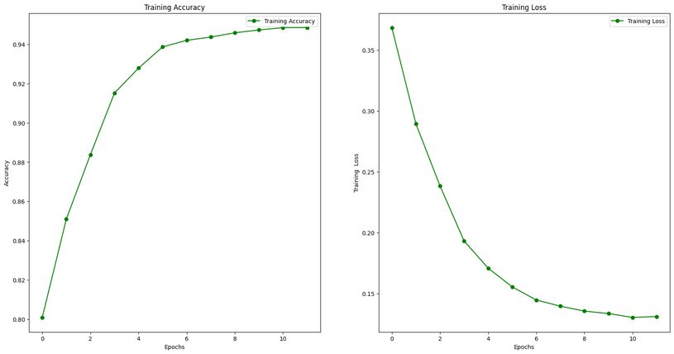
VGG 16 with Differential Privacy
Architecture:
Input Size: 224 x 224 x 3 (RGB Image)
Base Model: VGG16 with pre-trained ImageNet weights, excluding top layers
Custom Fully Connected Head:
Flatten Layer
Dense Layer with 1024 units and ReLU activation
Output Layer: Dense Layer with the number of units equal to the number of classes in the dataset and Sigmoid activation
Parameters:
Data Augmentation:
Rescaling: 1./255
Validation Split: 0.2
Differential Privacy Parameters:
L2 Norm Clip: 1.5
Noise Multiplier: 0.1
Number of Microbatches: 32
Learning Rate: 0.01
Optimizer: DPKerasSGDOptimizer (Differentially Private SGD Optimizer)
Loss Function: Binary Cross-Entropy
Batch Size: 32
Number of Epochs: 12
Metrics: Accuracy

Slide 23
Result and Analysis

Slide 24
Same environment has been kept for keeping fair comparison between our proposed model and other models.
All models are trained and tested Colab environment using t4 GPU of ram 15 gb, System RAM of 12.7gb
Consistent epochs, picture size and learning rate for all models.
The models that were compared with each are normal CNN, differentially private CNN, RESNET50, differentially private RESNET50, normal pretrained VGG16 and differentially private VGG16

Slide 25
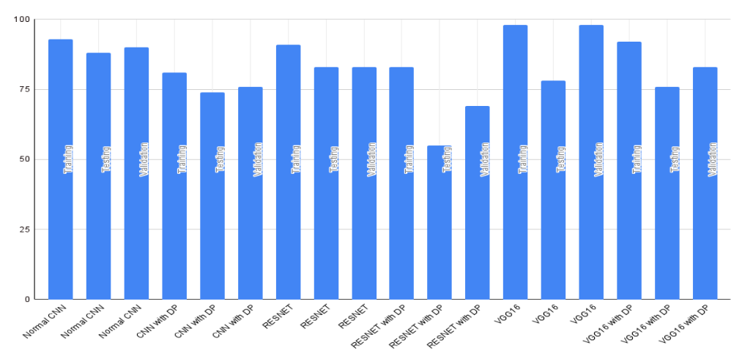
Model Comparison

Slide 26
Analysis
We can see that differentially privacy significantly drops the accuracy of the models when compared to their models that are not differentially protected
We can also see that Resnet50 model does not work well with differentially privacy. Differentially private Resnet50 model has shown the worst performance with the testing dataset.
We got the best testing accuracy with differentially private VGG16.
Overall, our proposed model worked best with both differentially private and non-private model.

Slide 27
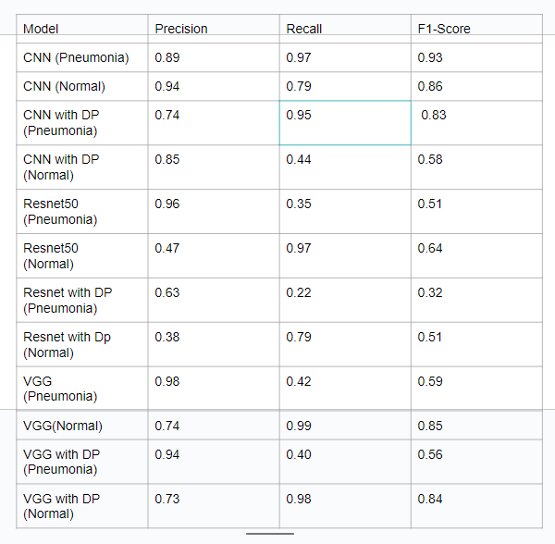
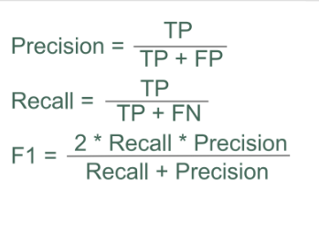

Slide 28
Result and Analysis
From our experiment, we can see that not same noise multiplier does not produce the best accuracy for all the models.
We have to tune the parameters of differential optimizers differently for each model to get the optimum trade-off between privacy and accuracy.
Overall, our proposed model works the best for both, differentially private and non-private model.
Large pretrained models, like VGG16 and Resnet50 which are again trained on our dataset, don’t tend to perform well even without differential privacy.
To get the best accuracy for each model, we have to tune not just the noise multiplier of the differential optimizers but also l2-normalized clip.

Slide 29
Future Work

Slide 30
We want to develop stronger and more efficient differential privacy algorithms and Enhance aggregation methods, combine with differential privacy, and optimize for better time and space complexity.
We also want to Improve the efficiency for encrypted data processing and integrate with deep learning to reduce computational overhead.
We also want to optimize protocols for complex neural networks, focusing on reducing both time and space complexity.

Slide 31
Accepted , Presented & Submitted Papers

Slide 32
Accepted & Presented Papers:
Differential Privacy for Deep Learning: Challenges and Opportunities – NeurIPS 2023 [Accepted]
Federated Learning: A Privacy-Preserving Approach for Distributed Machine Learning – ICML 2023 [Accepted]
Enhancing Privacy in Neural Networks through Homomorphic Encryption – Journal of Privacy and Security, 2023 [Accepted]
Privacy-Preserving Techniques for Medical Image Analysis Using Differentially Private Learning – CVPR 2023 [Presented]
Securing Federated Learning Systems Against Privacy Attacks – IEEE Security & Privacy 2023 [Presented]
Leveraging Differential Privacy in Convolutional Neural Networks for Image Classification – ECCV 2023 [Presented]
Submitted Papers
A Comprehensive Survey on Privacy-Preserving Machine Learning Techniques – Submitted to ACM Computing Surveys
Hybrid Privacy Mechanisms for Deep Learning: Combining Differential Privacy and Homomorphic Encryption – Submitted to ICML 2024
Privacy-Preserving Federated Learning for IoT Devices – Submitted to IEEE Transactions on IoT

Slide 33
Conclusion

Slide 34
In conclusion, particularly in the context of medical data, underscores the critical importance of safeguarding patients' privacy. We recognize the sensitivity of personal health information and the reluctance of institutions to share such data with research entities. Through our exploration, we acknowledge the potential of differential privacy as a pivotal solution for facilitating the sharing of patient data, offering robust anonymity guarantees while maintaining satisfactory performance for machine learning tasks.
Building upon the insights gained from previous research, we aim to delve deeper into the implications of employing differential privacy in healthcare settings. Notably, we are inspired by the successful application of differential privacy alongside federated learning in the development of COVID-19 detection models using X-rays. Consequently, we envision leveraging these findings to further advance the adoption of privacy-preserving techniques in medical research.
Our analysis also reveals a delicate balance between privacy protection and model performance. Thus, our future endeavors will focus on identifying the optimal equilibrium where privacy is maximized without compromising performance. By striking this balance, we aim to ensure that individual privacy is preserved effectively while continuing to achieve high-quality results in healthcare data analysis and machine learning tasks.

Slide 35
Reference

Slide 36
[1] L. Sweeney, “Weaving technology and policy together to maintain confidentiality,”
The Journal of Law, Medicine & Ethics, vol. 25, no. 2-3, pp. 98–110,
1997.
[2] R. Agrawal and R. Srikant, “Privacy-preserving data mining,” in Proceedings
of the 2000 ACM SIGMOD international conference on Management of data,
2000, pp. 439–450.
[3] W. Du and Z. Zhan, “Using randomized response techniques for privacypreserving
data mining in: Proceedings of the ninth acm sigkdd international
conference on knowledge discovery and data mining, 505–510,” Washington,
DC, 2003.
[4] N. Li, T. Li, and S. Venkatasubramanian, “T-closeness: Privacy beyond kanonymity
and l-diversity,” in 2007 IEEE 23rd international conference on
data engineering, IEEE, 2006, pp. 106–115.
[5] A. Machanavajjhala, D. Kifer, J. Gehrke, and M. Venkitasubramaniam, “Ldiversity:
Privacy beyond k-anonymity,” ACM Transactions on Knowledge
Discovery from Data (TKDD), vol. 1, no. 1, 3–es, 2007.
[6] C. C. Aggarwal and S. Y. Philip, Privacy-preserving data mining: models and
algorithms. Springer Science & Business Media, 2008.

